Slide 1
JAVASCRIPT DOM

Slide 2
HTML DOM
DOM stands for Document Object Model.
When a browser loads a web page, the browser creates a Document Object Model of that page. The HTML DOM is created as a tree of Objects. In the DOM, all HTML elements are defined as objects.
The HTML DOM is a standard for how to get, change, add, or delete HTML elements.
HTML DOM methods are actions you can perform (on HTML Elements).
HTML DOM properties are values (of HTML Elements) that you can set or change.
A property is a value that you can get or set (like changing the content of an HTML element).
A method is an action you can do (like add or deleting an HTML element).
The HTML DOM can be accessed with JavaScript (and with other programming languages).

Slide 3
Example:
<html>
<head>
<title>My Page Title</title>
</head>
<body>
<div>
<h1>This is browser DOM</h1>
</div>
<script type="text/javascript">
</script>
</body>
</html>

Slide 4
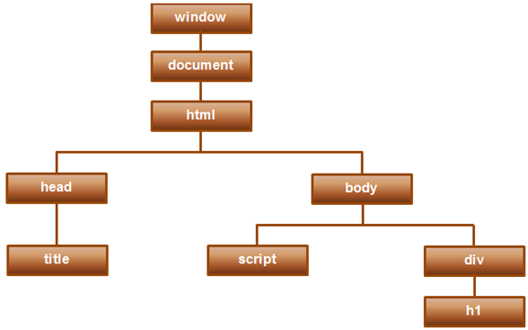
For the previous slide HTML, a graphical representation of the Document Object Model is shown below:
The window object represents the browser window. The document object represents the HTML document loaded in that window.

Slide 5
The getElementById Method
The most common way to access an HTML element is to use the id of the element.
In the example above the getElementById method used id="demo" to find the element.
The innerHTML Property
The easiest way to get the content of an element is by using the innerHTML property.
The innerHTML property is useful for getting or replacing the content of HTML elements.
Finding HTML Elements
Method Description :
document.getElementById(id) Find an element by element id document.getElementsByTagName(name) Find elements by tag name document.getElementsByClassName(name) Find elements by class name
Changing HTML Elements
Method Description
element.innerHTML = new html content :->Change the inner HTML of an element element.attribute = new value :->Change the attribute value of an HTML element element.setAttribute(attribute, value) :->Change the attribute value of an HTML element element.style.property = new style :->Change the style of an HTML element

Slide 6
Changing the Value of an Attribute
<!DOCTYPE html>
<html>
<body>
<img id="image" src="smiley.gif" width="160" height="120">
<script>
document.getElementById("image").src = "landscape.jpg";
</script>
<p>The original image was smiley.gif, but the script changed it to landscape.jpg</p>
</body>
</html>

Slide 7
Adding and Deleting Elements
Method | Description
document.createElement(element) | Create an HTML element
document.removeChild(element) | Remove an HTML element
document.appendChild(element) | Add an HTML element
document.replaceChild(element) | Replace an HTML element
document.write(text) | Write into the HTML output stream

Slide 8
createElement() method appendChild() method
The createElement() method creates an Element Node with the specified name.
The appendChild() method appends a node as the last child of a node.
Note: After the element is created, use the element.appendChild() or element.insertBefore() method to insert it to the document.

Slide 9
HTML DOM removeChild() Method
The removeChild() method removes a specified child node of the specified element.
Returns the removed node as a Node object, or null if the node does not exist.

Slide 10
HTML DOM replaceChild() Method
The replaceChild() method replaces a child node with a new node.
The new node could be an existing node in the document, or you can create a new node.

Slide 11
JavaScript can be used to access and modify these DOM objects and their properties. For example, you can add, modify and remove HTML elements and their attributes. Along the same lines, you can use DOM object properties to assign event handlers to events.
Assigning event handlers in JavaScript using DOM object property
<!DOCTYPE html>
<html>
<head>
</head>
<body>
<input type="button" value="Click me" id="btn"/>
<script type="text/javascript">
document.getElementById("btn").onmouseover = changeColorOnMouseOver;
document.getElementById("btn").onmouseout = changeColorOnMouseOut;
function changeColorOnMouseOver()
{
this.style.background = 'red';
this.style.color = 'yellow';
}

Slide 12
function changeColorOnMouseOut()
{
this.style.background = 'black';
this.style.color = 'white';
}
</script>
</body>
In this case, we are assigning event handlers using the DOM object properties (onmouseover & onmouseout) instead of using the attributes of the HTML tag. We are using this keyword to reference the current HTML element. In this example "this" references the button control.

Slide 13
The following example is same as the last one. In this case we are assigning an anonymous function to onmouseover & onmouseout properties.
<!DOCTYPE html>
<html>
<head>
</head>
<body>
<input type="button" value="Click me" id="btn" />
<script type="text/javascript">
document.getElementById("btn").onmouseover = function ()
{
this.style.background = 'red';
this.style.color = 'yellow';
}
document.getElementById("btn").onmouseout = function ()
{
this.style.background = 'black';
this.style.color = 'white';
}
</script>
</body>
</html>
.

Slide 14
If an event handler is assigned using both, i.e an HTML attribute and DOM object property, the handler that is assigned using the DOM object property overwrites the one assigned using HTML attribute. Here is an example.
<!DOCTYPE html>
<html>
<head>
</head>
<body>
<input type="button" value="Click me" id="btn" onclick="clickHandler1()"/>
<script type="text/javascript">
document.getElementById("btn").onclick = clickHandler2;
function clickHandler1()
{
alert("Handler set using HTML attribute");
}
function clickHandler2()
{
alert("Handler set using DOM object property");
}
</script>
</body>

Slide 15
Using this approach you can only assign one event handler method to a given event. The handler that is assigned last wins. In the following example, Handler2() is assigned after Handler1. So Handler2() owerites Handler1().
<!DOCTYPE html>
<html>
<head>
</head>
<body>
<input type="button" value="Click me" id="btn"/>
<script type="text/javascript">
document.getElementById("btn").onclick = clickHandler1;
document.getElementById("btn").onclick = clickHandler2;
function clickHandler1()
{
alert("Handler 1");
}
function clickHandler2()
{
alert("Handler 2");
}
</script>
</body>

Slide 16
Thank You

